Slide 1



Establish Ingestion and Extraction patterns using Azure and Snowflake.
(For Batch-time and Real-time)
Guided by- Amit Malik
Team Members-
Ashwin Nair
Rajat Mishra
Nehal Tiwari

Slide 2
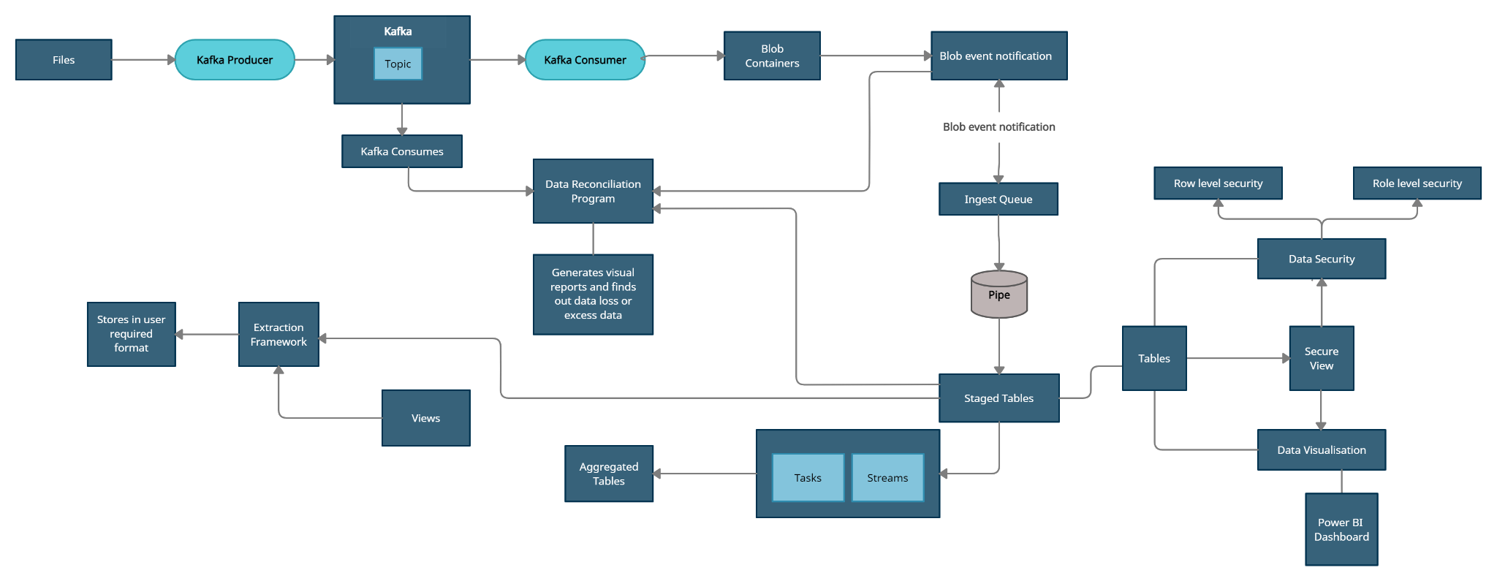
Work-flow:

Slide 3
Data Ingestion
Azure blob containers
kafka to azure
Kafka
Producer
Consumer
+
Blob client
files
containers
topic
Each kafka topic is mapped to a single azure storage which is in turn mapped to a snowflake database.

Slide 4
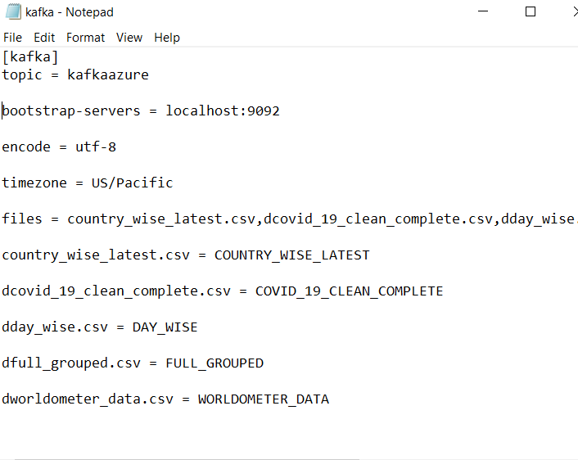
Data Ingestion
Kafka config specifies topic and maps each file to table

Slide 5
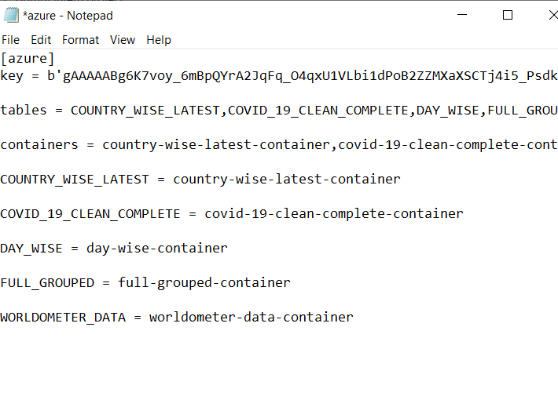
Data Ingestion
Setting up azure config file for consumer code to connect to Azure

Slide 6
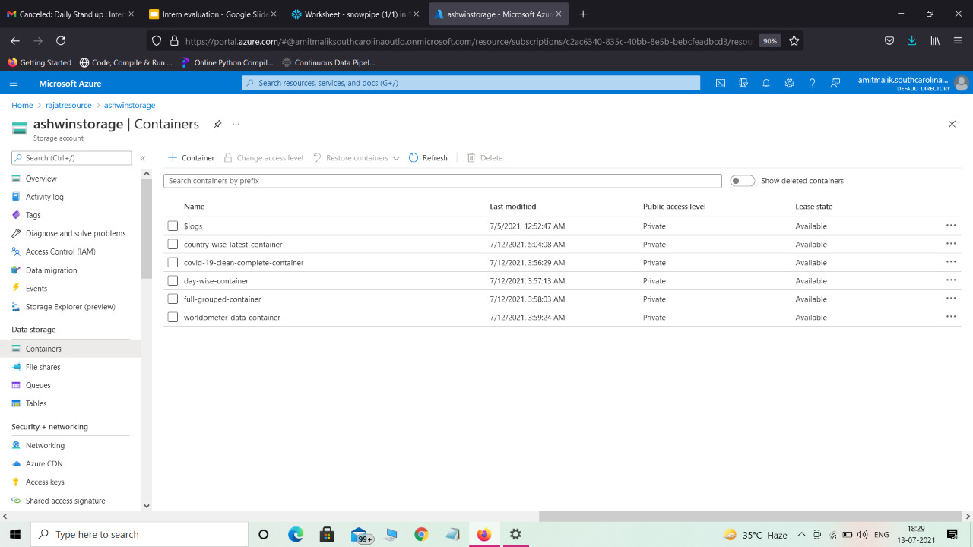
Data Ingestion
Image depicting the mapped containers inn azure storage

Slide 7
Data Reconciliation
Kafka topic
External Azure stage
Snowflake table
Collecting row data via consumer
Collecting all row tuples
Collecting all rows from staged tables
Processing Data to find Missing rows or additional rows found During ingestion

Slide 8
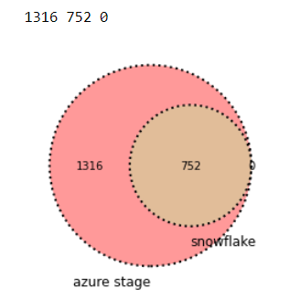
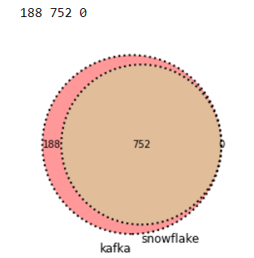
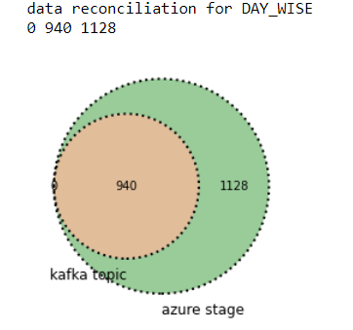
Data Reconciliation
Accessible visuals and dataframes in python program

Slide 9
Data Reconciliation
The program provides a dictionary of dictionary of tables with missing Data
Country_wise_latest
table_name
table_name
table_name
table_name
Missing rows kafka to azure
Additional rows found in azure
Missing rows azure to snowflake
Additional rows in snowflake from other sources
Missing rows kafka to snowflake
Additional rows snowflake
Data representation in Tabular format

Slide 10
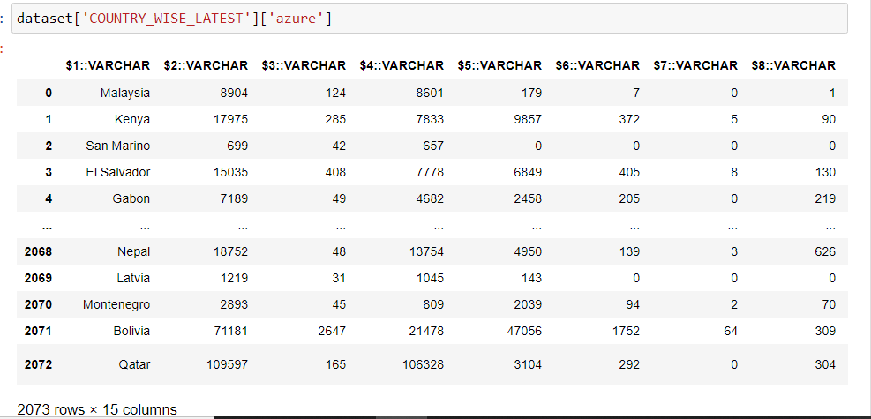
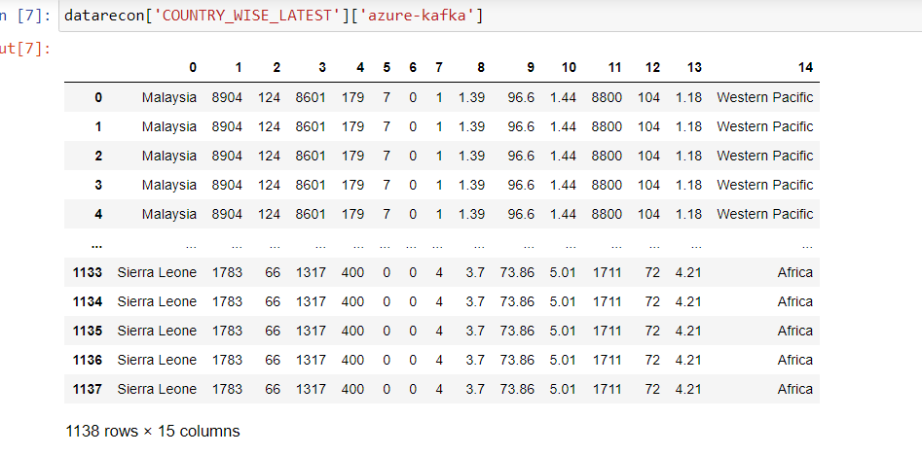
Data Reconciliation
Identification of Missing Records

Slide 11
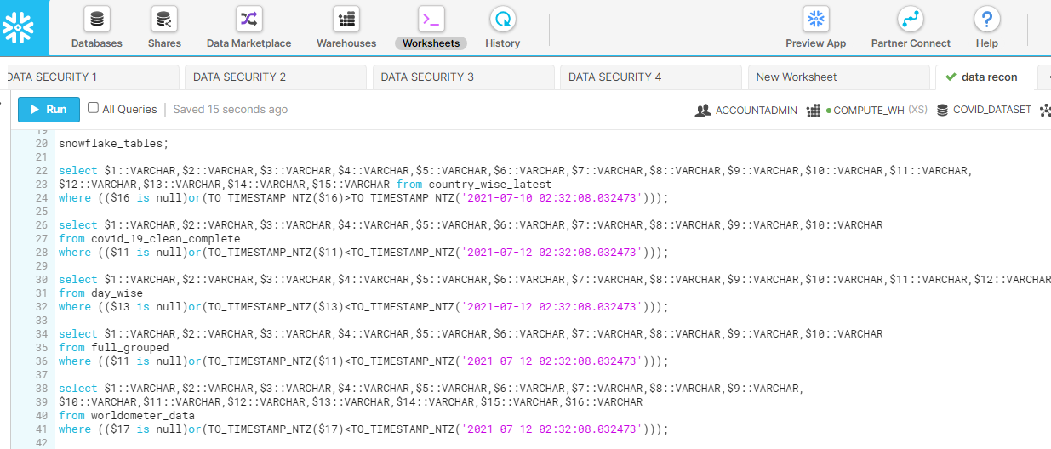
Data Reconciliation
Sql code used by python to access table data from snowflake

Slide 12
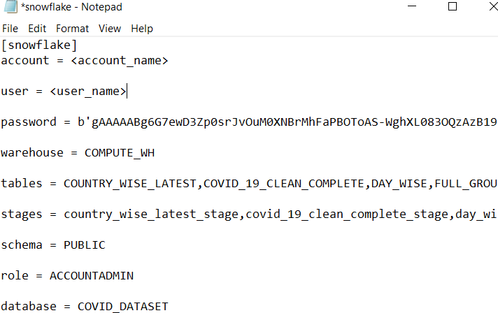
Data Reconciliation
Setting snowflake config file to connect python code to snowflake

Slide 13
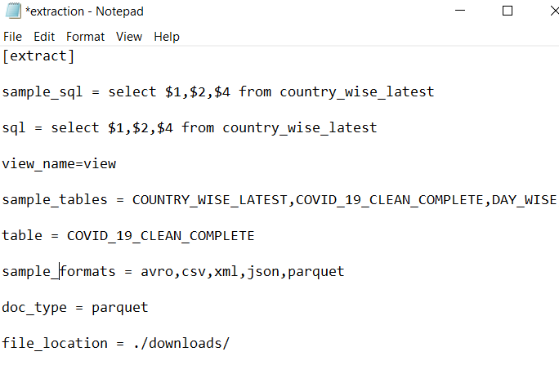
Data Extraction
Setting the config file to download a view or table in the required file format

Slide 14
Data Extraction
View/Table from snowflake
Snowflake Python Connector
Getting table/view as Dataframe
xml
csv
parquet
avro
json

Slide 15
Establish Ingestion and Extraction patterns using Azure and Snowflake.
(For Batch-time and Real-time)
Guided by- Amit Malik
Team Members-
Ashwin Nair
Rajat Mishra
Nehal Tiwari

Slide 16
Work-flow:

Slide 17
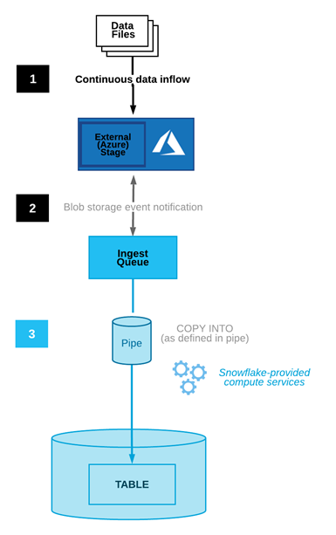
Data Ingestion
Snowpipe’s auto-ingest feature
Event Subscription
1
Notification Integration
2
Snowpipe
3

Slide 18
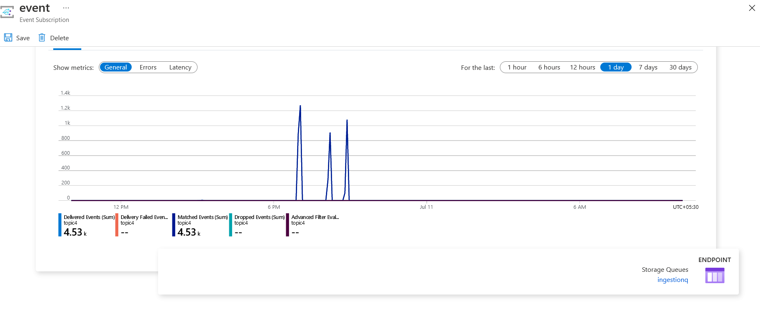
Data Ingestion
Connecting Azure Blob Containers with Ingestion Queue via Event Subscription.

Slide 19

Data Ingestion
Connecting the Ingestion Queue with Snowflake Stage(external) via Notification Integration.
Queue containing data files
External stage object
Snowpipe
Notifies Snowflake whenever new data arrives

Slide 20
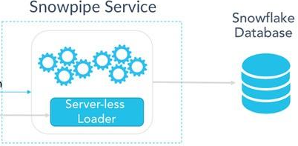

Data Ingestion
Snowpipe Automatically loading data into Snowflake Table.

Slide 21
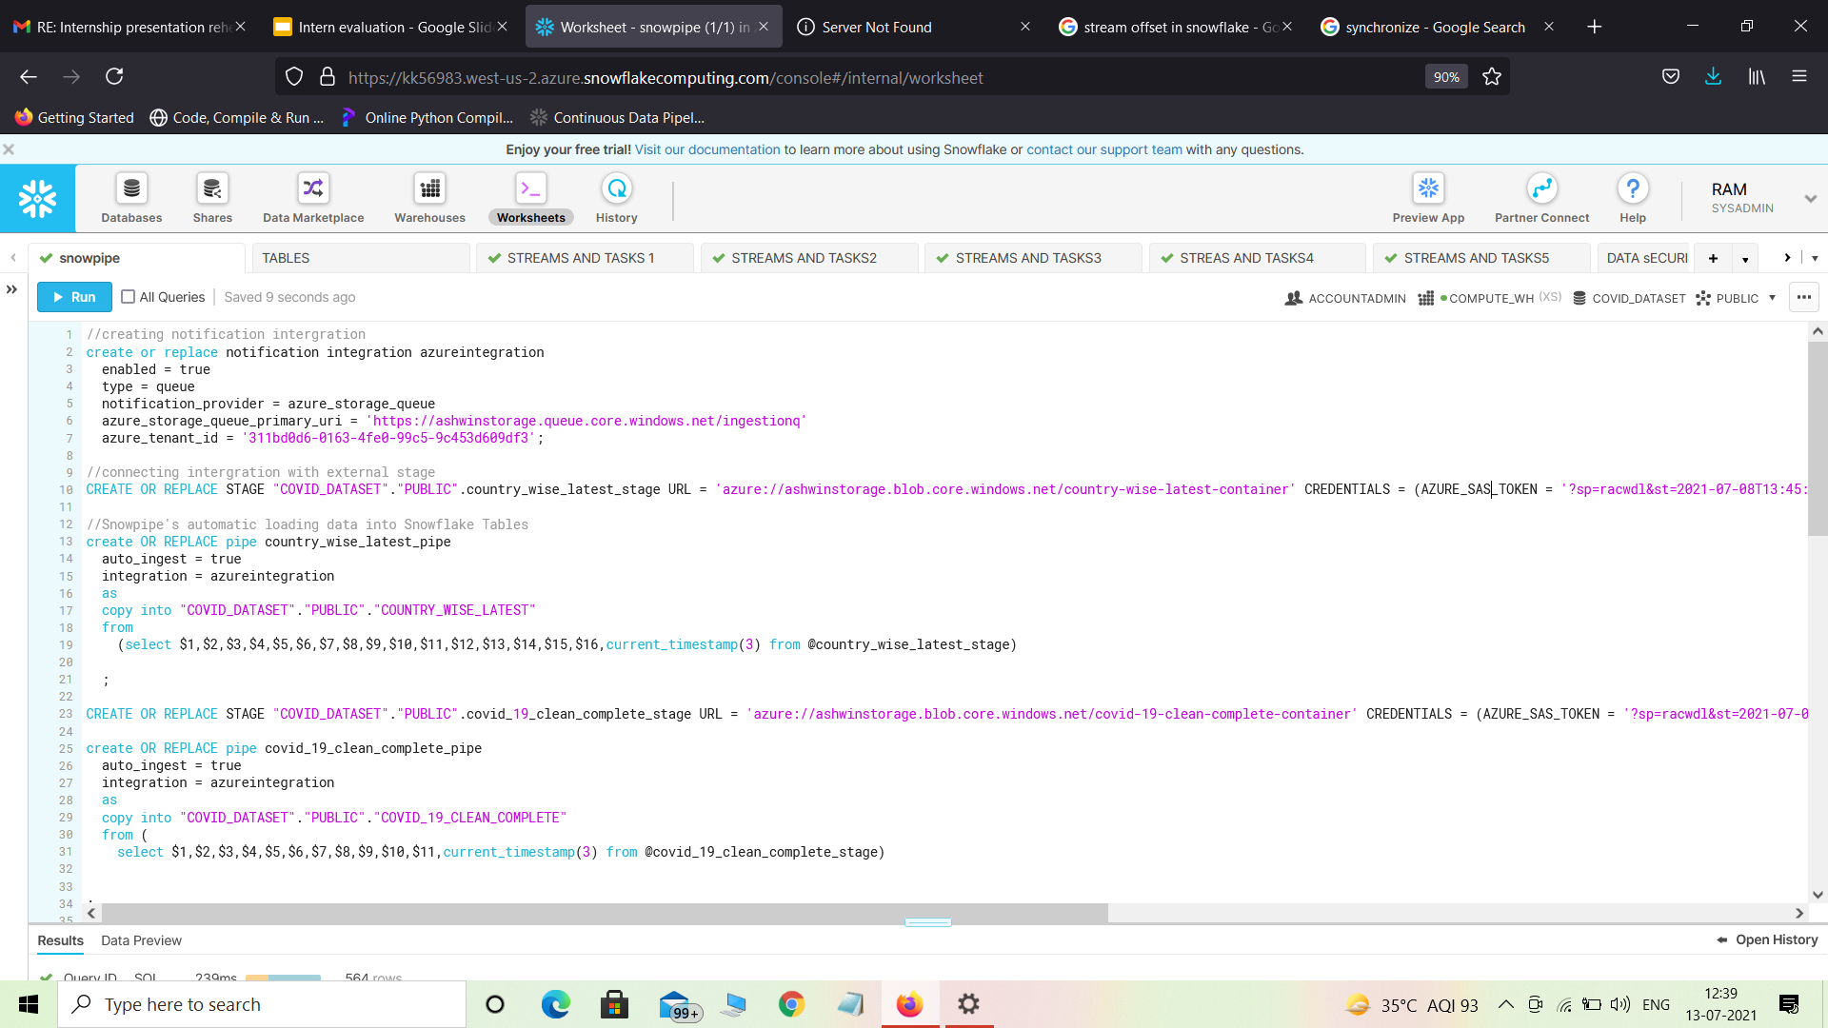
Code Snippets

Slide 22
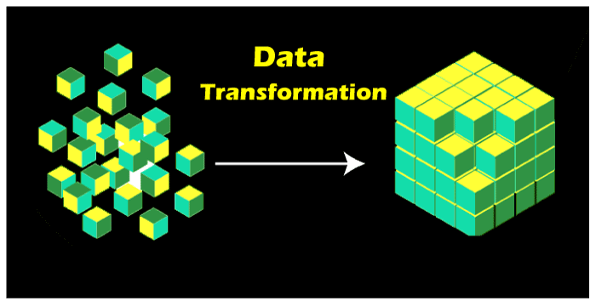
Data Transformation
Why Data Transformation?
Data is transformed to make it better-organized.Transformed data would be easier for both humans and computers to use.It acts as a power booster for the Data analytics process.

Slide 23
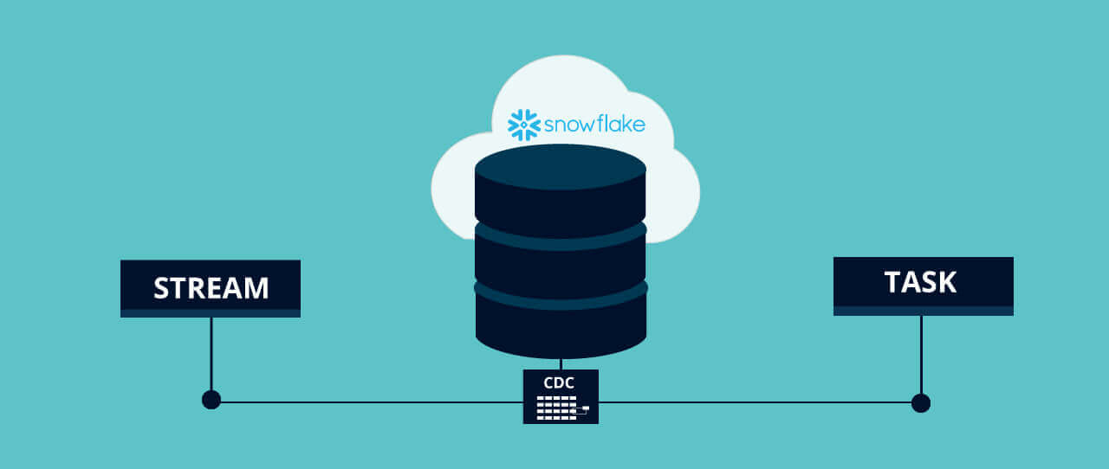
Data Transformation
What are Streams and Tasks?
A stream is a Snowflake object type that provides change data capture (CDC).
A Task consumes these streams to run a scheduled query.

Slide 24
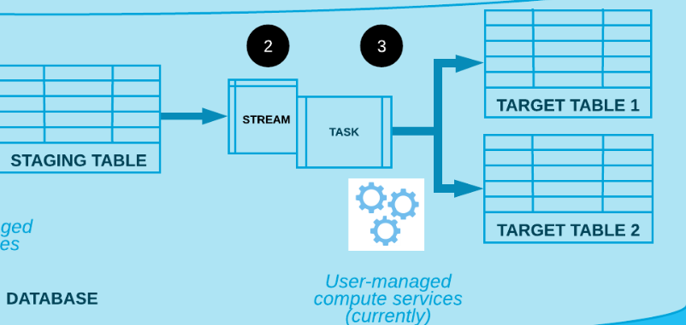
Data Transformation
How Do Streams and Tasks work?
1
Raw Data
Aggregated Data

Slide 25
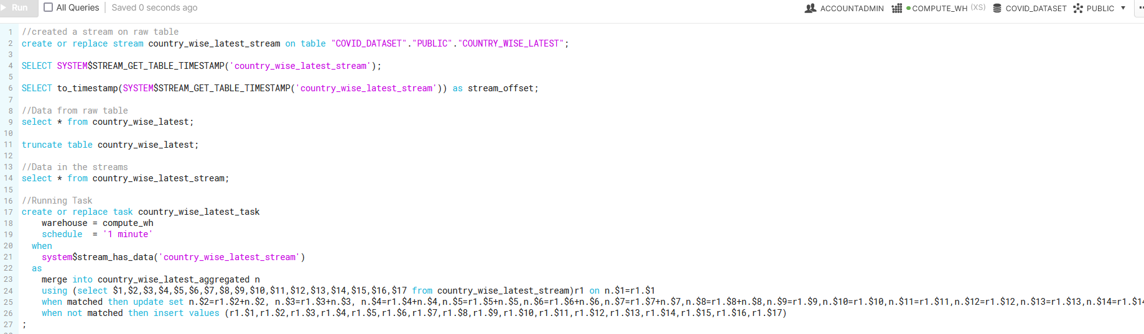
Code Snippets

Slide 26
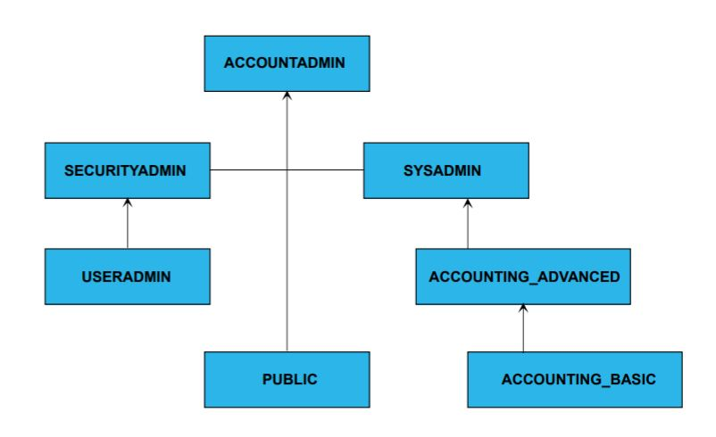
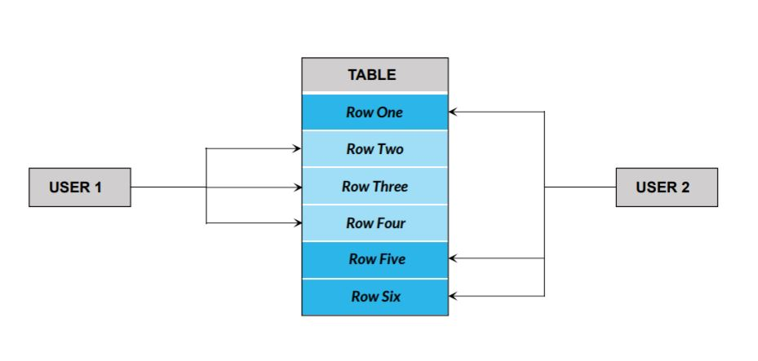
Data Security
Most important aspect of data handling.
Role level and row level access.
4 roles created coherent with the data set used.

Slide 27




We have created four roles aligning to the dataset we have been using:
WHO Role
PMO India Role
BRICS Role
SAARC Role

Slide 28
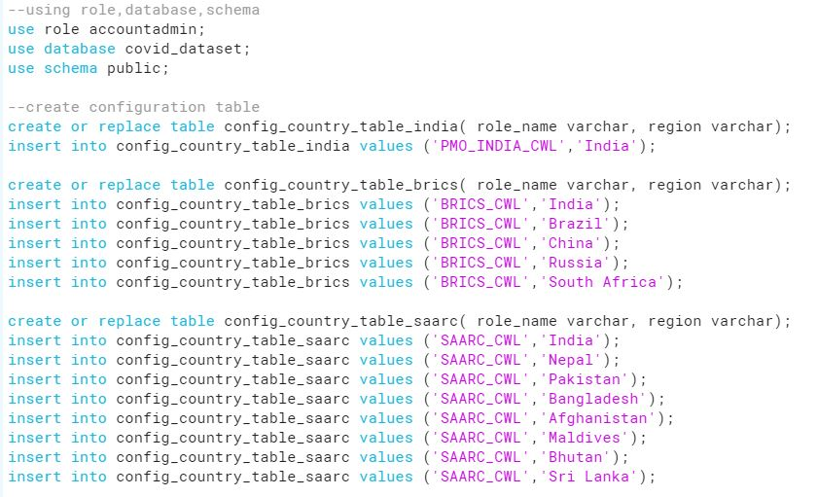
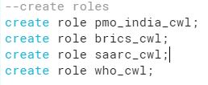
Code overview
1. Creating Configuration tables:
2. Creating roles:

Slide 29
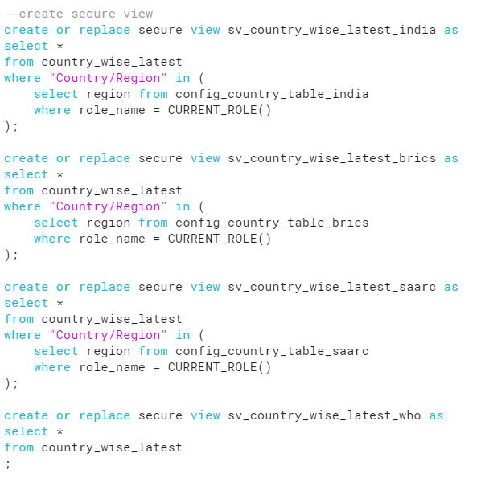
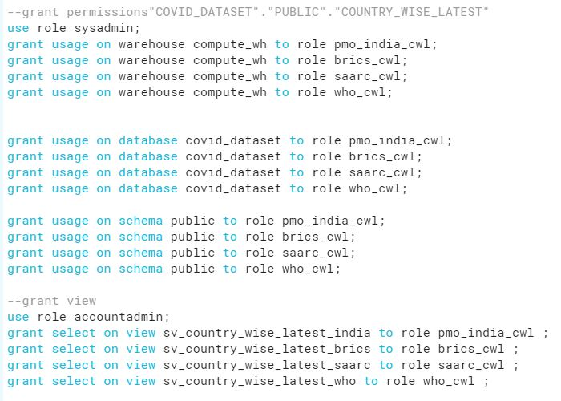
4. Granting permissions for usage on warehouse, database, schema and secure view:
3. Creating secure views:

Slide 30
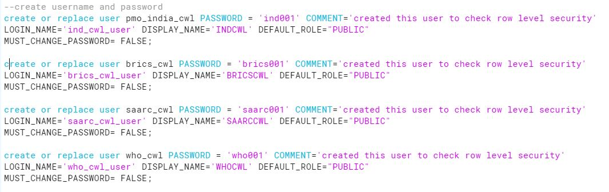
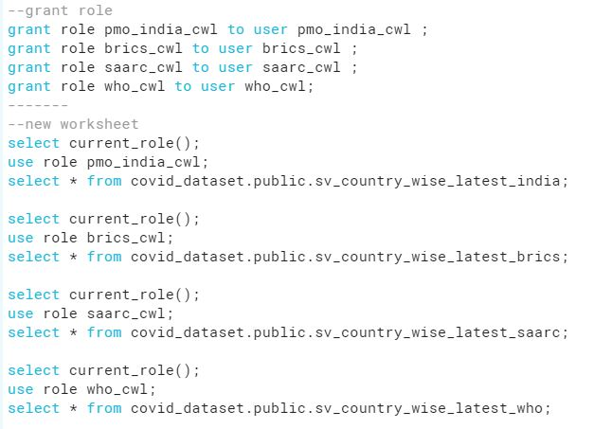
5. Creating usernames and passwords for each roles:
6. Granting roles to users for login in secure views:

Slide 31
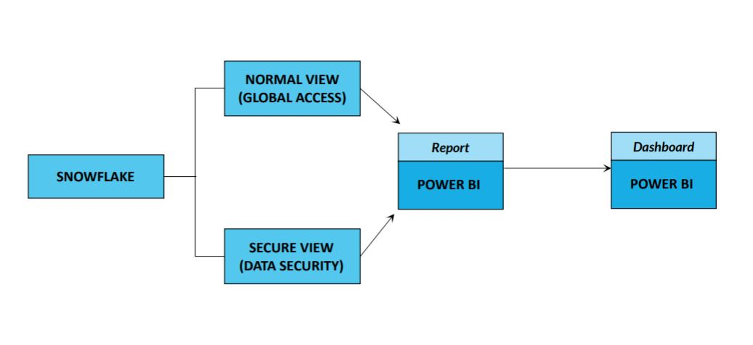
Data Visualisation
Dashboard for visual representation of data using Power BI.
Facilitated comparison between countries.
Visualisation helps in understanding the dataset better.

Slide 32
Takeaways
Rajat Mishra :
Never Hesitate to ask your doubts with your seniors/mentors/peers. Clarify it before its late.
Learning your team members and synchronizing with them is a key aspect.
Ashwin Nair :
Identifying core strengths of team members helps in overall project execution
Helping your team mates boosts team coordination and team efficiency
Nehal Tiwari :
No matter how unexplored field is, there is always a way to ace it by learning.
Coordinating between members of team for a better finished product.

Slide 33


Slide 34
THANK YOU!!

